Slide 1
Getting Started with Learning PowerShell

Slide 2
Why Learn PowerShell?
It is everywhere
All Microsoft Products use it
PowerShell questions on Microsoft certification exams
Allows for interoperability between products
As an IT Professional, you need it to stay relevant

Slide 3
Why Learn PowerShell?
It will save time
It is less error prone
It is self-documenting
It is the Microsoft standard for automation
Everything you learn applies to everything else
https://blogs.technet.microsoft.com/heyscriptingguy/2015/01/02/weekend-scripter-why-should-i-learn-powershell/

Slide 4
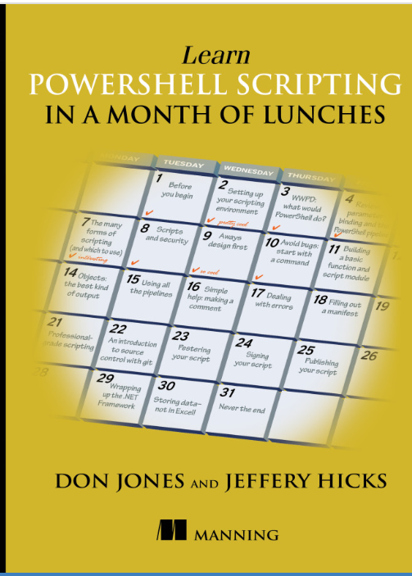
Learn PowerShell Scripting in a Month of Lunches
Latest version is November 2017
27 chapters, bite sized learning and lab activity in each chapter
Use code sljones for 42% discount
https://www.manning.com/books/learn-powershell-scripting-in-a-month-of-lunches

Slide 5
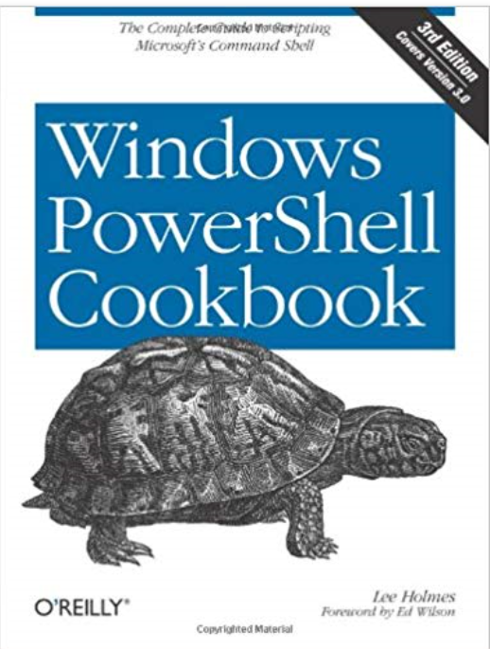
Windows PowerShell Cookbook: The Complete Guide to Scripting Microsoft’s Command Shell
Lots of examples
https://read.amazon.com/kp/embed?asin=B00ARN9MEK&preview=newtab&linkCode=kpe&ref_=cm_sw_r_kb_dp_KDxlCbEPQEMCF

Slide 6
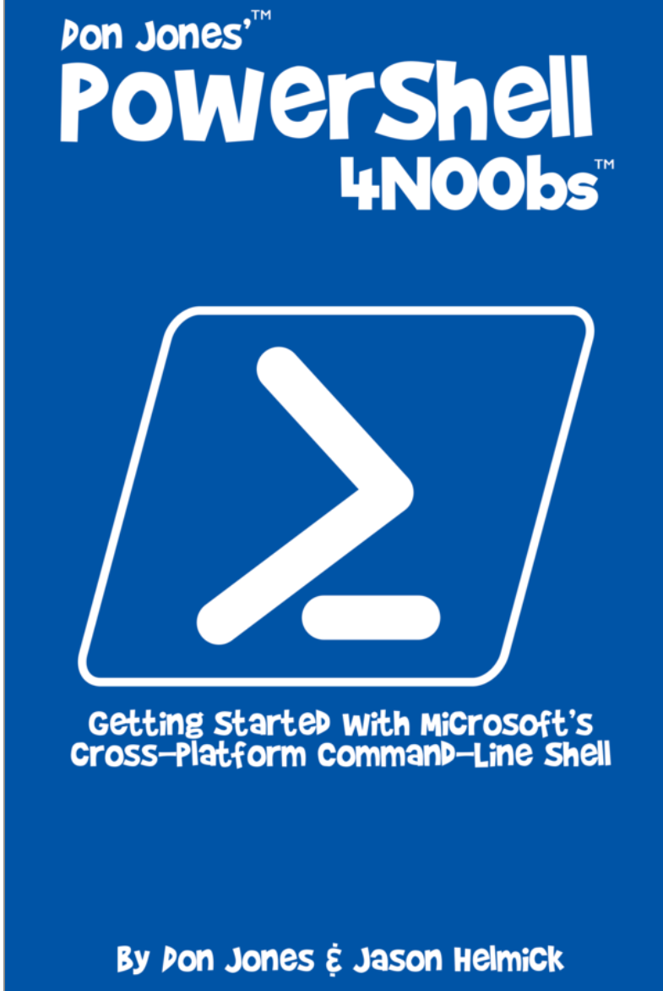
PowerShell 4N00bs
New book, very inexpensive, pay what you can
Short, only 107 pages
Includes cross platform use and PowerShell Core
https://leanpub.com/powershell-4n00bs

Slide 7
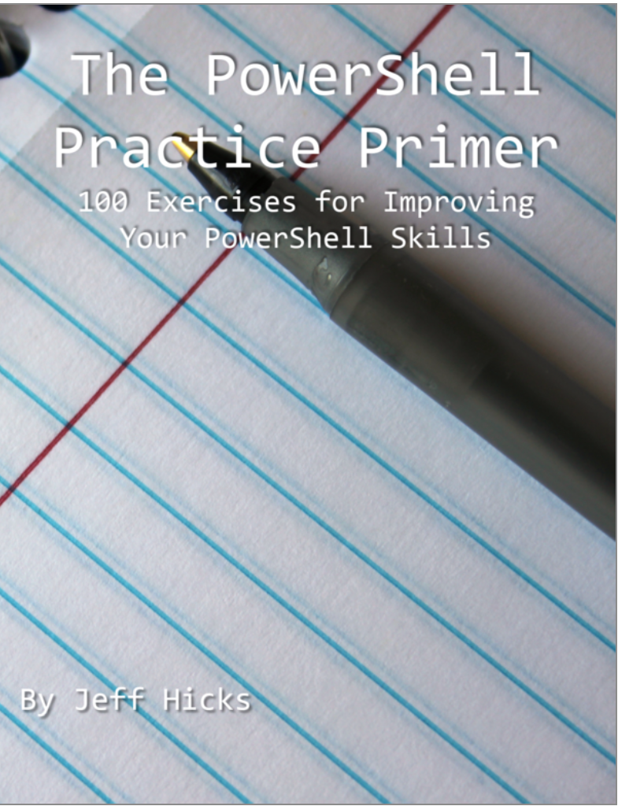
PowerShell Practice Primer
Learn by doing
Problems, Hints and Solutions to work through
https://leanpub.com/psprimer

Slide 8
PowerShell.org
Community Driven website
Free eBooks
Forums
Summit OnRamp – designed for those with no PowerShell experience (4 tickets left)
April 29th – May 2nd in Bellevue, WA (Seattle)
YouTube Channel - https://www.youtube.com/powershellorg

Slide 9
Reddit r/PowerShell
https://www.reddit.com/r/PowerShell/
Chat room for help
Many people asking typical questions

Slide 10
The Scripting Guy Blog
Lots of great material
Use Search to find the blog article you need
https://blogs.technet.microsoft.com/heyscriptingguy/

Slide 11
PowerShell Gallery
Very active, 28 million downloads per month
https://www.powershellgallery.com/
Always remember, just because it’s on the gallery, doesn’t make it good code, Test and Verify

Slide 12
Microsoft Virtual Academy
Free, but getting replaced with something else in 2019
What's new in PowerShell 5==> still valid and accurate because this is the most deployed version https://mva.microsoft.com/en-US/training-courses/whats-new-in-powershell-v5-16434
Getting started with Microsoft PowerShell https://mva.microsoft.com/en-US/training-courses/getting-started-with-microsoft-powershell-8276
Advanced Tools & Scripting with PowerShell 3.0 Jump Start==> Don't be scared by the version number because the information is still valid and accurate for PowerShell 5 https://mva.microsoft.com/en-US/training-courses/advanced-tools-scripting-with-powershell-30-jump-start-8277
Getting Started with PowerShell Desired State Configuration https://mva.microsoft.com/en-US/training-courses/getting-started-with-powershell-desired-state-configuration-dsc-8672
Advanced PowerShell Desired State Configuration (DSC) and Custom Resources https://mva.microsoft.com/en-US/training-courses/advanced-powershell-desired-state-configuration-dsc-and-custom-resources-8702

Slide 13

Pluralsight.com
Website full of training, requires subsciption
PowerShell Essentials Track
5 hours of beginner
7 hours of intermediate
4 hours of advanced
PowerShell Scripting and Toolmaking
11 hours of beginner
8 hours of intermediate
14 hours of advanced

